Slide 1
MUTHAYAMMAL ENGINEERING COLLEGE (AUTONOMUS),
RASIPURAM – 637 408
DEPARTMENT OF ELECTRICAL AND ELECTRONICS ENGINEERING
RECENT TRENDS IN POWER ELECTRONICS
08/08/2016
Prepared by,
Dr.S.Saravanan,
Professor & Head / EEE
Muthayammal Engineering College

Slide 2
Outline
Electronics
What is power electronics?
The history
Applications
A simple example
About this course
Power
2

Slide 3
I. What is power electronics?
Electronics
Definition
Relation with information electronics
The interdisciplinary nature
Position and significance in the human society
Power
3

Slide 4
1) Definition
Electronics
Power Electronics:
is the electronics applied to conversion and control of electric power.
Range of power scale :
milliwatts(mW) megawatts(MW) gigawatts(GW)
A more exact explanation:
The primary task of power electronics is to process and
control the flow of electric energy by supplying voltages and currents in a form that is optimally suited for user loads.
Power
4

Slide 5

Conversion of electric power
Electronics
Electric
Power Converter
Other names for electric power converter:
-Power converter
-Converter
-Switching converter
-Power electronic circuit
-Power electronic converter
Power
Power
input
output
Control input
Power
Two types of electric power DC(Direct Current) | Changeable properties in conversion Magnitude
AC (Alternating Current) | Frequency, magnitude, number of phases
5

Slide 6




Classification of power converters
Electronics
Power output Power input | DC | AC
AC | AC to DC converter (Rectifier) | AC to AC converter ( Fixed frequency : AC controller Variable frequency: Cycloconverter or frequency converter)
DC | DC to DC converter (Chopper) | DC to AC converter (Inverter)
Power
6

Slide 7
Power electronic system
Electronics
Generic structure of a power electronic system
Power Converter
Power
Power output
input
 | Control
Controller
input
Feedforward/Feedback
Feedback/Feedforward
Power
( measurements of input signals )
Reference ^{signals )} (commanding)
( measurements of output
Control is invariably required.
Power converter along with its controller including the
corresponding measurement and interface circuits, is also called power electronic system.
7

Slide 8
Typical power sources and loads for a power electronic system
Electronics
Power input
Power Converter
Power output
i_{o} V_{o}
Feedback/ Feed forward
Source
Load
V_{i} i_{i}
-Electric utility
-battery
-other electric energy source
-power converter
-Electric Motor
-light
-heating
-power converter
-other electric or electronic equipme
Controller
Reference
Power
The task of power electronics has been recently extended to also ensuring the currents and power consumed by power converters and loads to meet the requirement of electric energy sources.
8

Slide 9
2) Relation with information electronics
Electronics
A Classification of electronics by processing object
Information electronics: to process information
Power electronics: to process electric power
Electronics
Other classifications of electronics
Vacuum electronics: using vacuum devices,
e.g, vacuum tubes devices
Solid (Solid state) electronics: using solid state devices,
e.g, semiconductor devices
Power
Electronics
Physical electronics: physics,material,fabrication,
and manufacturing of electronic devices
Applied electronics: application of electronic
devices to various areas
Electronics
9

Slide 10

3) The interdisciplinary nature
Electronics
William E. Newell’s description
Electronics
Power
Static & rotating
Devices,circuits
power equipment
Power Electronics
Continuous, discrete Control
Power
Power electronics is the interface between
electronics and power.
10

Slide 11










Relation with multiple disciplines
Electronics
Systems & Control theory
Signal processing
Circuit theory
Simulation & computing
Electric machines
Power electronics
Electronics
Power
Power systems
Solid state physics
Electromagnetics
Power electronics is currently the most active discipline in electric power engineering worldwide.

Slide 12
4) Position and significance in the human society
Electronics
Electric power is used in almost every aspect and everywhere of modern human society.
Electric power is the major form of energy source used in modern human society.
The objective of power electronics is exactly about how to use electric power, and how to use it effectively and efficiently, and how to improve the quality and utilization of electric power.
Power electronics and information electronics make two poles of modern technology and human society—— information electronics is the brain,and power electronics is the muscle.
Power

Slide 13

II. The history
Electronics
Application of fast-switching fully-controlled semiconductor devices
Invention of Thyristor
GTO GTR
Mercury arc rectifier Vacuum-tube rectifier Thyratron
1900 1957
Power diode Thyristor
IGBT
Power MOSFET Thyristor
Power MOSFET Thyristor
(microprocessor)
(DSP)
mid 1970s
late 1980s
Power
Pre-history
1st phase
2nd phase
3rd phase
The thread of the power electronics history precisely follows and matches the break-through and evolution of power electronic devices

Slide 14
III. Applications
Electronics
Industrial
Transportation Utility systems
Power supplies for all kinds of electronic equipment
Residential and home appliances Space technology
Other applications
Power

Slide 15

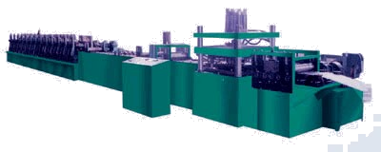

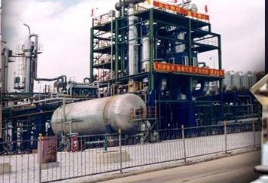

Industrial applications
Electronics
Motor drives
Electrolysis Electroplating Induction heating Welding
Arc furnaces and ovens Lighting
Power

Slide 16
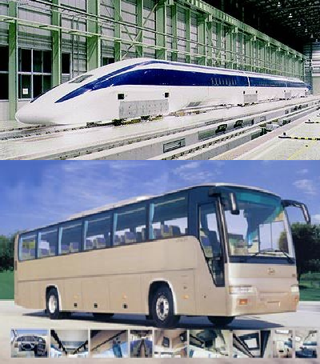
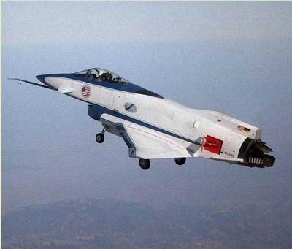
Transportation applications
Electronics
Trains & locomotives
Subways Trolley buses
Magnetic levitation Electric vehicles
Automotive electronics Ship power systems Aircraft power systems
Power

Slide 17
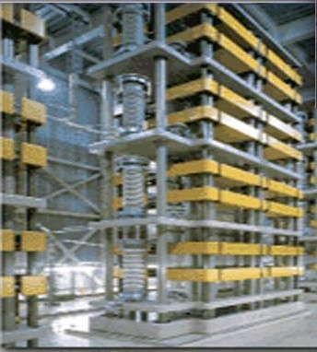
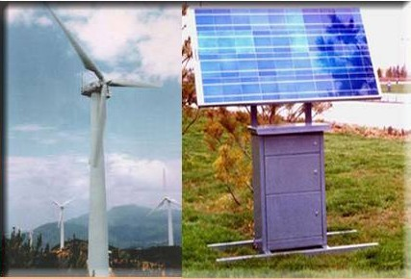
Utility systems applications
Electronics
High-voltage dc transmission(HVDC)
Flexible ac transmission(FACTS)
Static var compensation & harmonics suppression: TCR, TSC, SVG, APF
Custom power & power quality control
Supplemental energy sources :
wind, photovoltaic, fuel cells Energy storage systems
Power

Slide 18
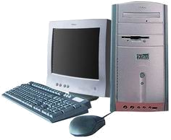


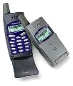
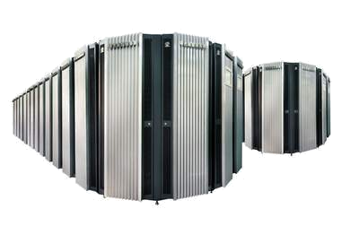
Power supplies for electronic equipment
Electronics
Telecommunications
Computers
Office equipment
computer
server
Power
Electronic instruments
Portable or mobile electronics
Telecommunication

Slide 19
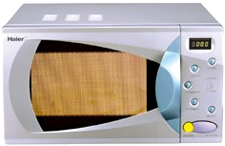



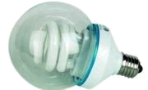
Residential and home appliances
Electronics
Lighting
Heating
Air conditioning Refrigeration & freezers Cooking
Cleaning Entertaining
Power

Slide 20
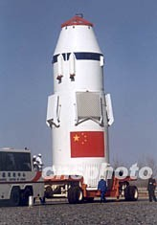

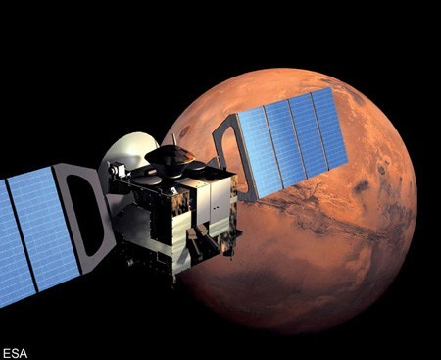
Applications in space technology
Electronics
Spaceship power systems
Satellite power systems
Space vehicle power systems
Power

Slide 21
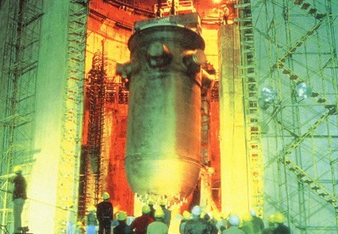
Other applications
Electronics
Nuclear reactor control
Power systems for particle accelerators
Environmental engineering
Power

Slide 22
Trends
Electronics
It is estimated that in developed countries now 60% of the electric energy goes through some kind of power electronics converters before it is finally used.
Power electronics has been making major contributions to:
--better performance of power supplies and better control of electric equipment
--energy saving
--environment protection
reduction of energy consumption leads to less pollution
reduction of pollution produced by power converters direct applications to environment protection technology
Power

Slide 23
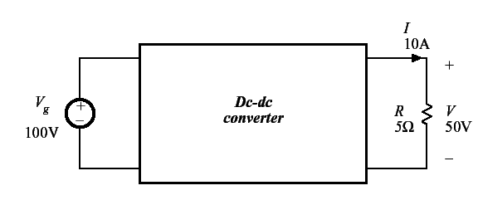
IV. A simple example
Electronics
A simple dc-dc converter example
Power
Input source:100V
Output load:50V, 10A, 500W
How can this converter be realized?

Slide 24
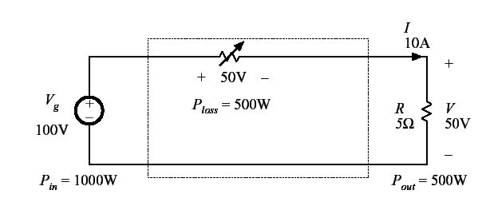
Dissipative realization
Electronics
Resistive voltage divider
Power

Slide 25
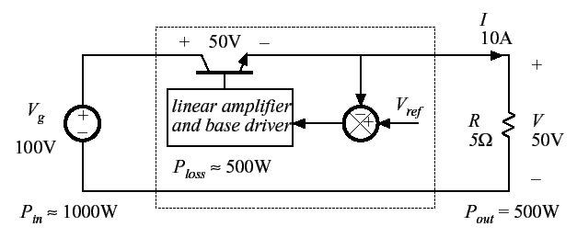
Dissipative realization
Electronics
Series pass regulator:
transistor operates in active region
Power

Slide 26
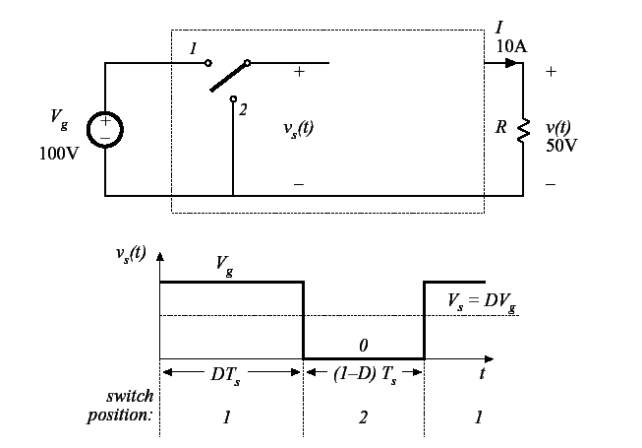
Use of a SPDT switch
Electronics
Power
SPDT: Single pole double throw

Slide 27
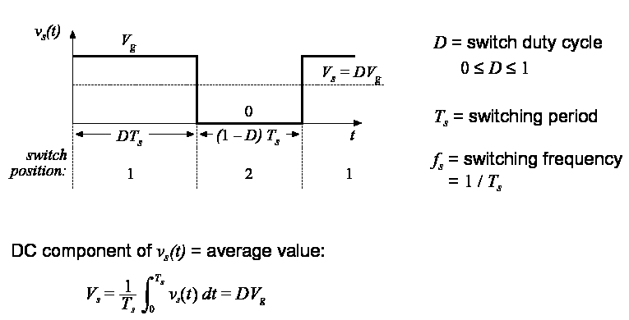
The switch changes the dc voltage level
Electronics
Power

Slide 28
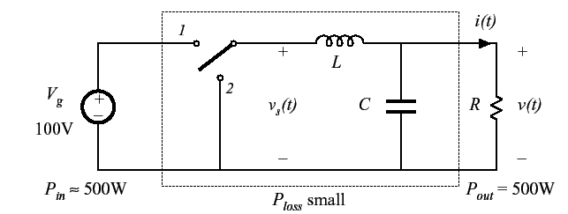
Addition of low pass filter
Electronics
Addition of (ideally lossless) L-C low-pass filter, for removal of switching harmonics:
Power
Choose filter cutoff frequency f0 much smaller than switching frequency fs
This circuit is known as the “buck converter”

Slide 29
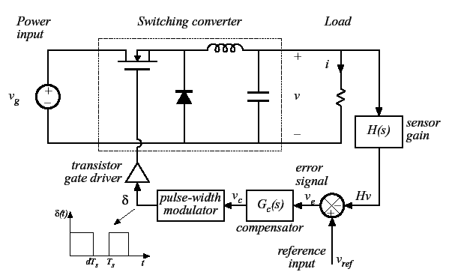
Addition of control system for regulation of output voltage
Electronics
Power

Slide 30
Major issues in power electronics
Electronics
How to meet the requirement of the load or gain better control of the load
How to improve the efficiency
--for reliable operation of power semiconductor devices
--for energy saving
How to realize power conversion with less volume, less weight, and less cost
How to reduce negative influence to other equipment in the electric power system and to the electromagnetic environment
Power

Slide 31
THANK YOU

